Slide 1

The application of DFT and FFT in image steganography & (Photovoltaic PV fault detect) Instructor: Prof. Christian Langen Student 1: Phuong Tu Anh, Nguyen _ Matriculation number: 98074 Student 2: Hoang Khang Le_Matriculation number:98083

Slide 2

Content:
Introduction to the aim of this project
Theory background:
Image Steganography:
3.1. The algorithm of Image Steganography by DFT and FFT:
3.2. The overview of Matlab code explantions:
3.3. The results of Matlab stimulation:
4. Extra: Fault detection:
4.1. Moving Average Filter
4.2. Normal state and Fault behavior
4.3. Fault characteristic and detection

Slide 3

The aim of this project:
This project is to implement the Discrete Fourier Transform (DFT) and Fast Fourier Transform (FFT) techniques for:
Image Steganography: Leverage DFT and FFT to embed hidden messages within an image in the frequency domain and accurately extract these messages.
(Extra) Photovoltaic fault detection: Use DFT techniques to analyze electrical signals from photovoltaic systems and detect faults in real-time.

Slide 4

Theory background:
Fourier Transform – Khang Le
Discrete Fourier Transform – Anh Nguyen
Image processing – Anh Nguyen

Slide 5
Theory Background

Slide 6
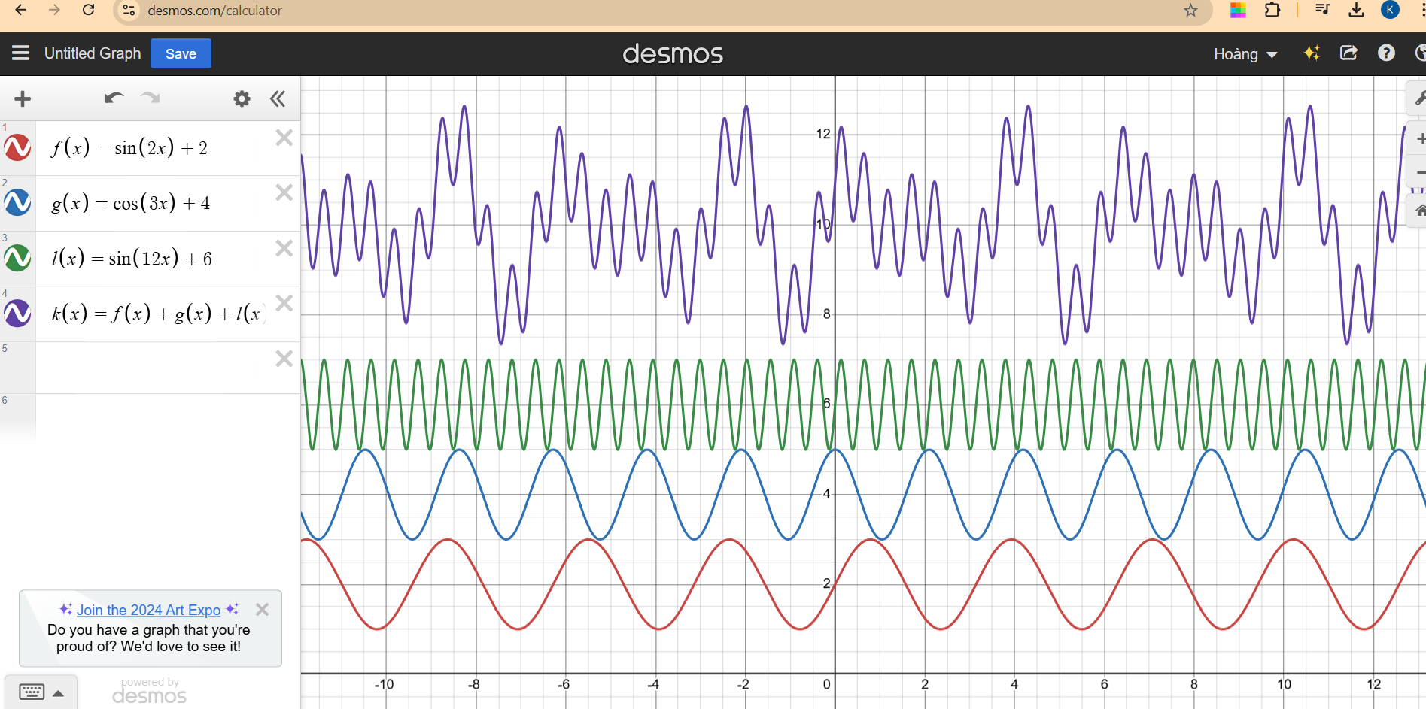
Fourier Transform
https://www.desmos.com/calculator/kfmba8fpwy
Notes:
Fourier transform is an interesting function. And it is the answer for the question how can we unmix a complicated signal we record from the real life. Why? Take an example the microphone can measure the air pressure and then give us a signal like this:

Slide 7
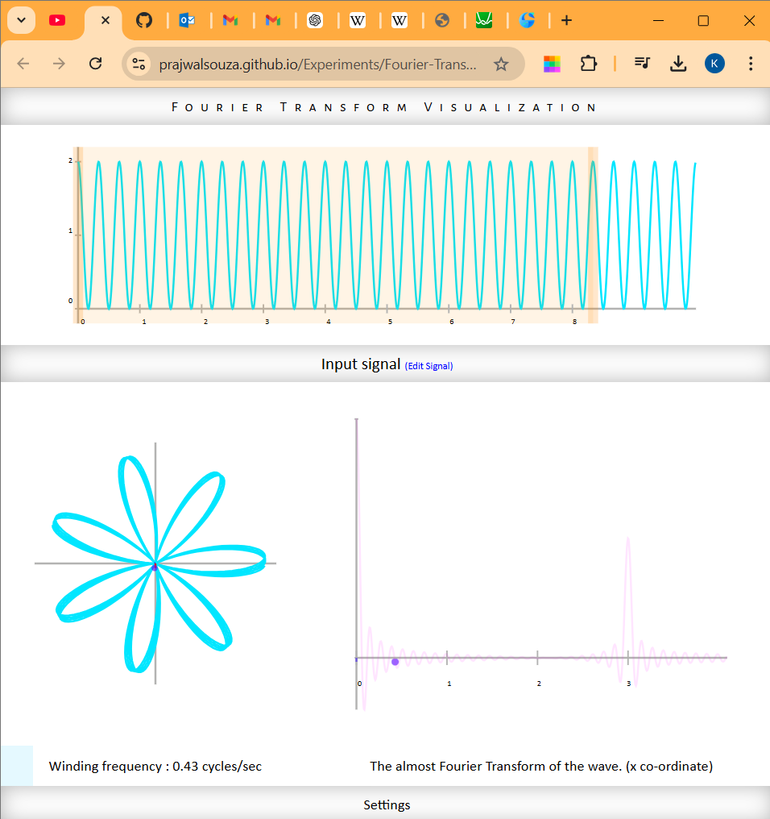
Fourier transform
Imagine that all the signal wrapping around a circle 2 frequency :
The frequency of the signal which is 3 Hz.
The frequency of a rotation around the circle.
https://prajwalsouza.github.io/Experiments/Fourier-Transform-Visualization.html

Slide 8
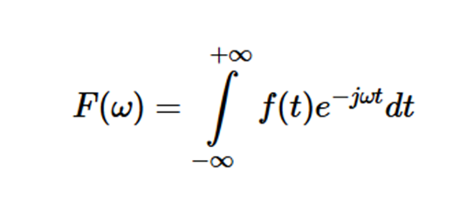
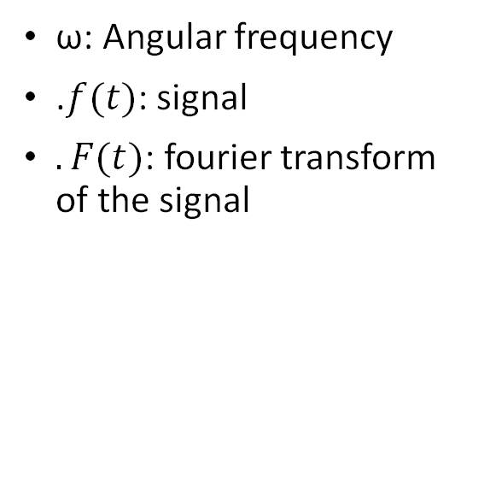
Fourier Transform
ω: Angular frequency
.$f(t)$: signal
$.F(t)$: fourier transform of the signal

Slide 9
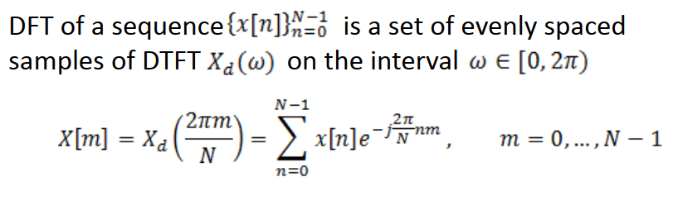
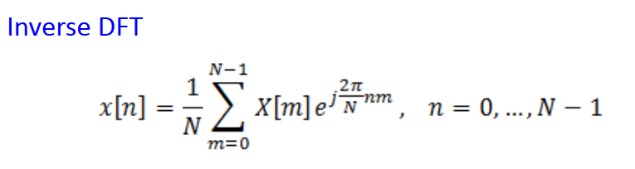
DFT
Notes:
The last DFT sample X[N-1] is to the left of =2
X[m] is periodic (period N) due to the 2 periodicity of DTFT
DFT is on almost every single computer in the world expect some with the log in amplifier which can replace the DFT, for this log in amplifier we just now the function of it but futher more information we don’t know.
DFT is powerful but it is also required some significantly important components that is the sampling rate. There is a thereon which is called Nyquist theorem, which on the next slide

Slide 10
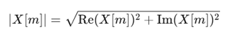
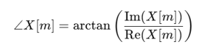
DFT – Properties
Magnitude Spectrum Modifications and Phase Modifications in the DFT
Notes:
•Magnitude Spectrum Modifications and Phase Modifications in the DFT: can be implemented by representing a signal in the frequency domain and allowing specific adjustments to its spectral components before reconstructing it back to the time or spatial domain.

Slide 11
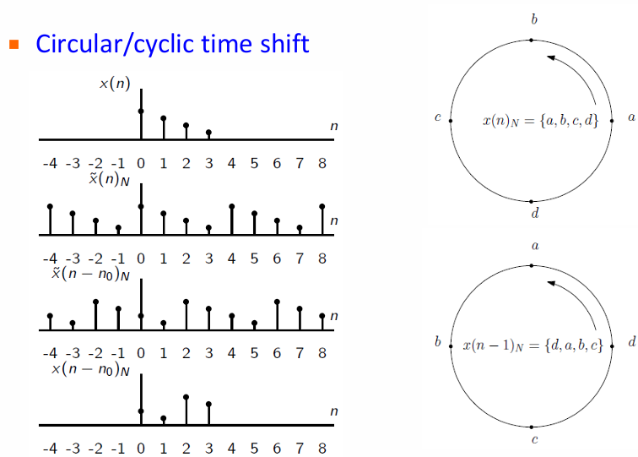
DFT - The circular/cyclic time shift
Notes:
The circular/cyclic time shift property of the DFT decribes how a shift in the time domain affects the frequency domain representation of a signal. In steganography, circular time shift is useful for designing robust data encoding schemes against small modifications or cropping. This periodicity ensures resilience in steganography methods.

Slide 12
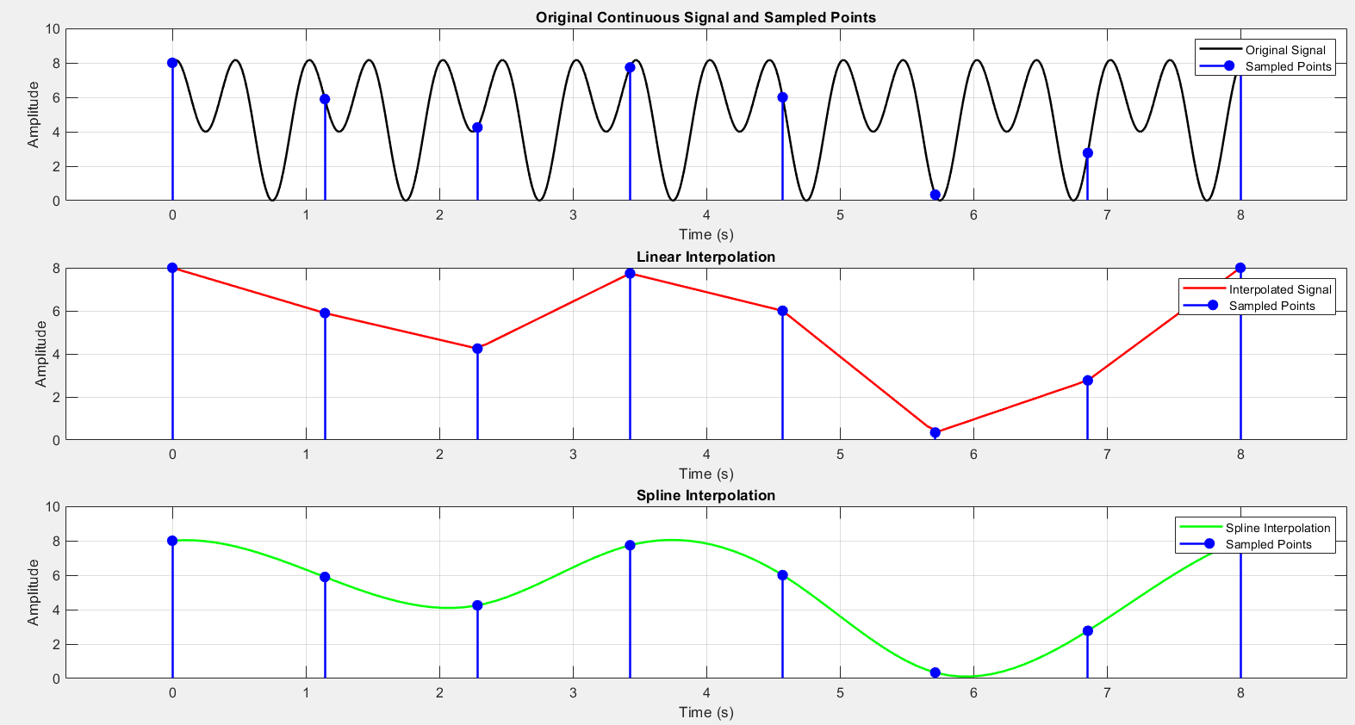
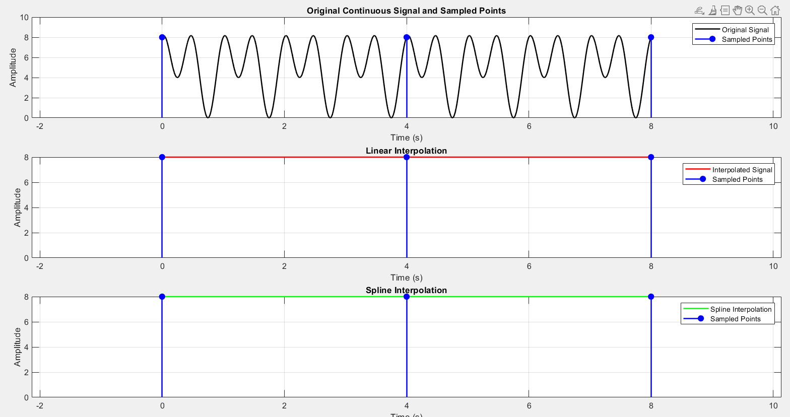
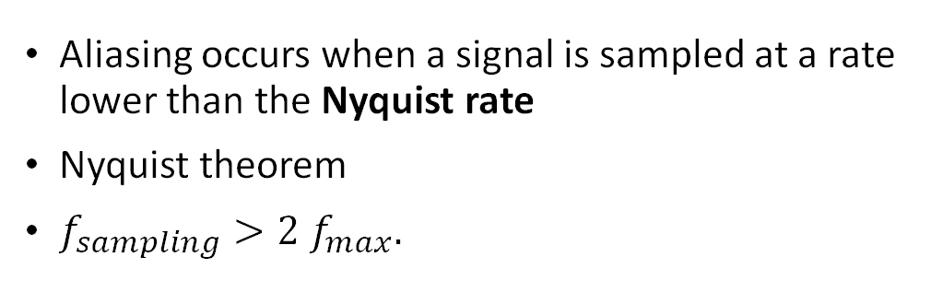
DFT - Aliasing
Aliasing occurs when a signal is sampled at a rate lower than the Nyquist rate
Nyquist theorem
$f_{sampling}>2 f_{max}.$

Slide 13
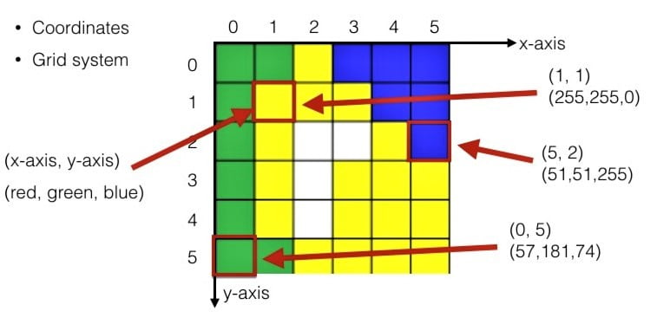
Image Processing
Pixel:
A pixel is the smallest unit of a digital image, representing a single point in the image grid.
Notes:
In grayscale images, each pixel has an intensity value. In color images, each pixel contains color information, typically represented as combinations of Red, Green, and Blue values. Regarding to Pixel Intensity Analysis, Pixel values are brightness, contrast, and color distribution. Besides, patterns or features (e.g. edges, textures) are detected based on variations in pixel intensities.
Pixels are also a segment grouped or classified into meaningful regions based on intensity, color, or other attributes. In Steganography, pixel values are modified slightly to hide secret data by altering the least significant bit of pixel intensity. On the contrary, in the extraction process, hidden information is retrieved by analyzing specific pixel values or their patterns.

Slide 14
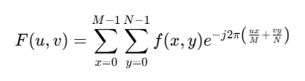
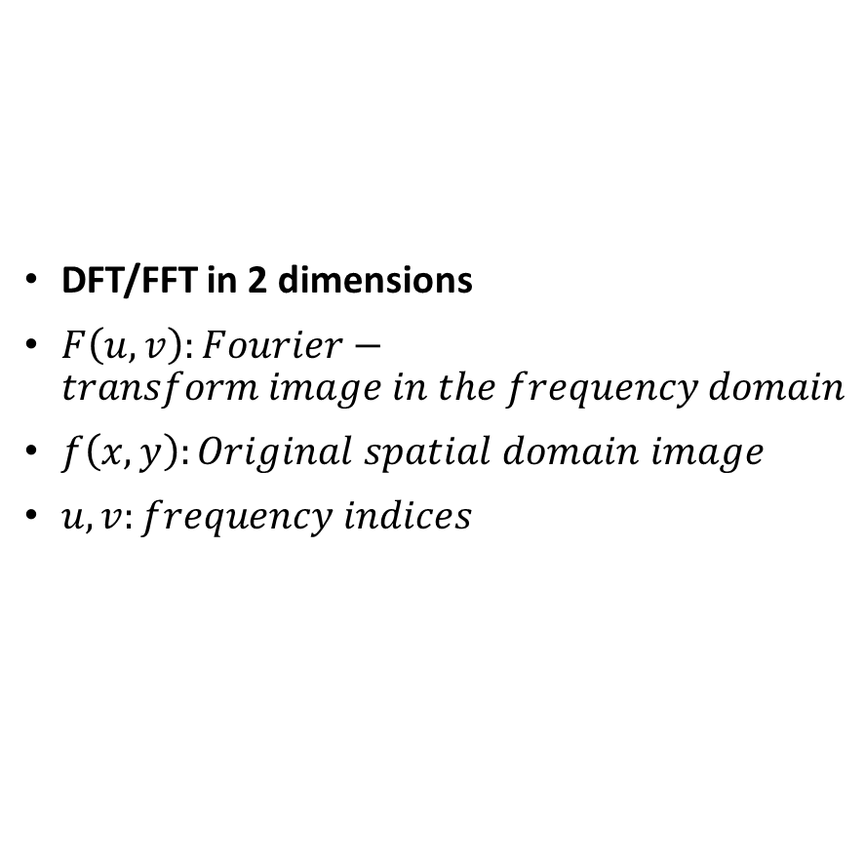
Image processing
DFT/FFT in 2 dimensions
$F\left(u,v\right):Fourier−transform image in the frequency domain$
$f\left(x,y\right):Original spatial domain image$
$u,v:frequency indices$
Notes:
The FFT in 2 dimensions is the same with the DFT in 1 dimension. So why it is in 2D. Beacause our image is not presented in 1D but in 2D with x and y axis. So bc of this it is simple to apply DFT not only in rows but also in columns. So now the formula is complicated but the matlab is handling this for us.

Slide 15
METHODS OF IMAGE STEGANOGRAPHY
Image Steganography
Spatial Domain
Transform Domain
LSB
PVD
EMD
Others
FFT
DCT
DWT
Lah-Transform

Slide 16
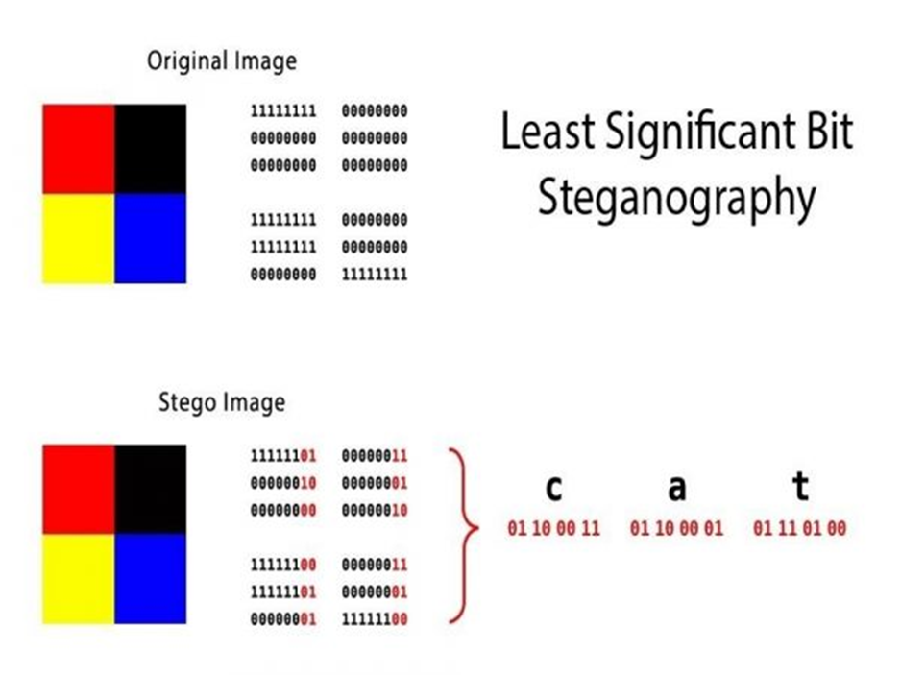
Least Significant bit - method
change the last bit value of a pixel, there won’t be much visible change in the color.
Notes:
Steganography is the method of hiding secret data inside any form of digital media. The main idea behind steganography is to hide the existence of data in any medium like audio, video, image, etc. When we talk about image steganography, the idea is quite simple. Images are made up of pixels which usually refer to the color of that particular pixel. In a grayscale (black and white) image, these pixel values range from 0-255, 0 being black and 255 being white.
The idea behind LSB embedding is that if we change the last bit value of a pixel, there won’t be much visible change in the color. For example, 0 is black. Changing the value to 1 won’t make much of a difference since it is still black, just a lighter shade.

Slide 17
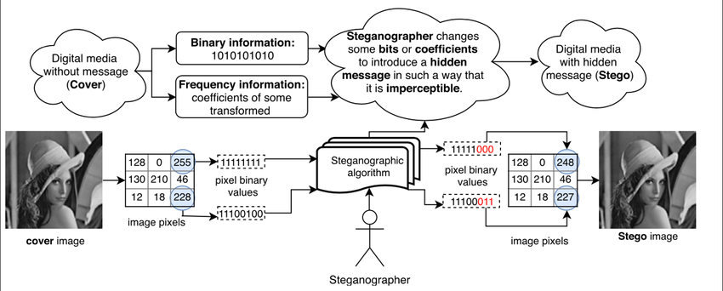
Least Significant bit - method
Basic LSB process – [1]
Notes:
Advantage:
• This method is very fast and easy to implement in comparison to other methods of image Steganography.
• The output image has very slight difference to the input image.
• Instead of embedding the message in only the LSB, we can embed the message in last two LSBs, thus embedding even large messages.
• This method forms the basics of many other complex algorithms
• Instead of embedding the message in only the LSB, we can embed the message in last two LSBs, thus embedding even large messages.
Disadvantages of this method:
• This type of encoding the data is weak since it can be easily decoded by taking the LSBs of the image and getting the message in binary format.
• This is method is too old because it was used long ago when other encoding methods were not yet developed.
• When embedding the message in more than one LSB, the image quality may reduce depending on how many pixels are changed.

Slide 18
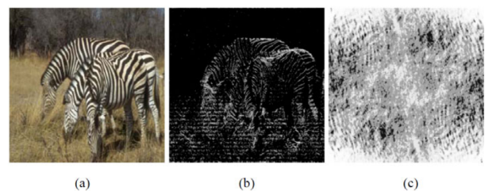
FFT method
(a) Zebras image, (b) Inverse Fourier transform of exp( j.θ(u,v) ) (the phase-only image of the Red-channel of the Zebras image). (c) Inverse Fourier transform of |F(u,v)| (the magnitude-only image of the Red-channel of the Zebras image) [1]
Notes:
Clearly, the phase-only image retains many of the features of the original. By contrast, the magnitude-only image, i.e., the inverse Fourier transform of |F(u,v)|, shown in figure 1-(c), bears no resemblance to the original image.
The discussion in the previous section suggests that, as long as the Fourier phase of an image is maintained intact, the overall appearance of an image remains specious if the Fourier magnitude of the image is slightly modified.

Slide 19
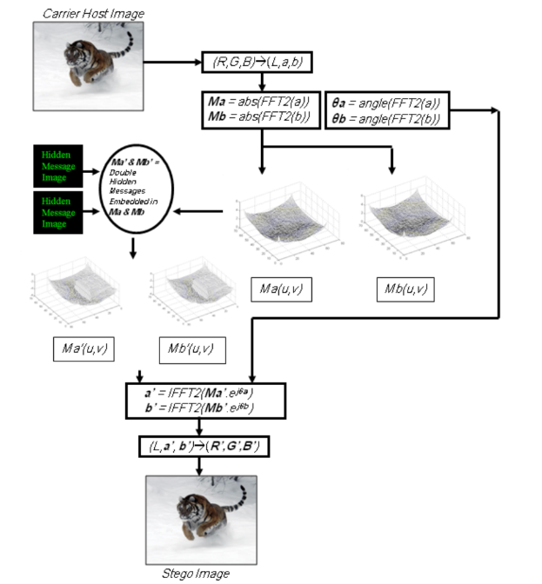
Fast Fourier Transform method
The technique used to embed a hidden message image into the Fourier magnitude of the chrominance channels of the carrier image is to replace the low-frequency areas in the Fourier magnitude spectrum with the values of the hidden message’s image
Notes:
1st separate the color carrier image using the CIE L*a*b* color space [24], [11]. L*a*b* space is a nonlinear transformation of RGB space These luminance/chrominance properties discussed above prompt us to embed two hidden messages inside the Fourier magnitude of the chrominance channels (one hidden message in the chrominance-a channel and a second hidden message in the
chrominance-b channel) while preserving the luminance channel unaltered for optimal visual quality.
2nd embed a hidden message image into the Fourier magnitude of the chrominance channels of the carrier image is to replace the high-frequency areas in the Fourier magnitude spectrum with the values of the hidden message’s image.
3rd IFFT 2D the modified magnitude and phase to the RGB image

Slide 20
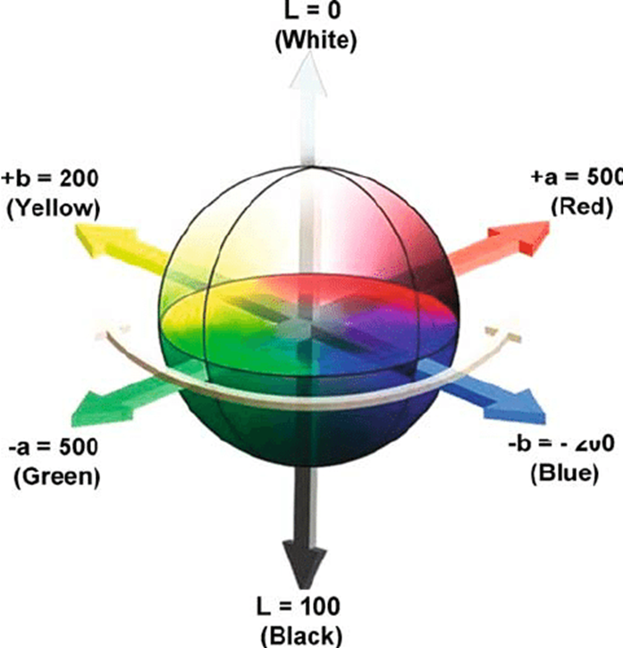
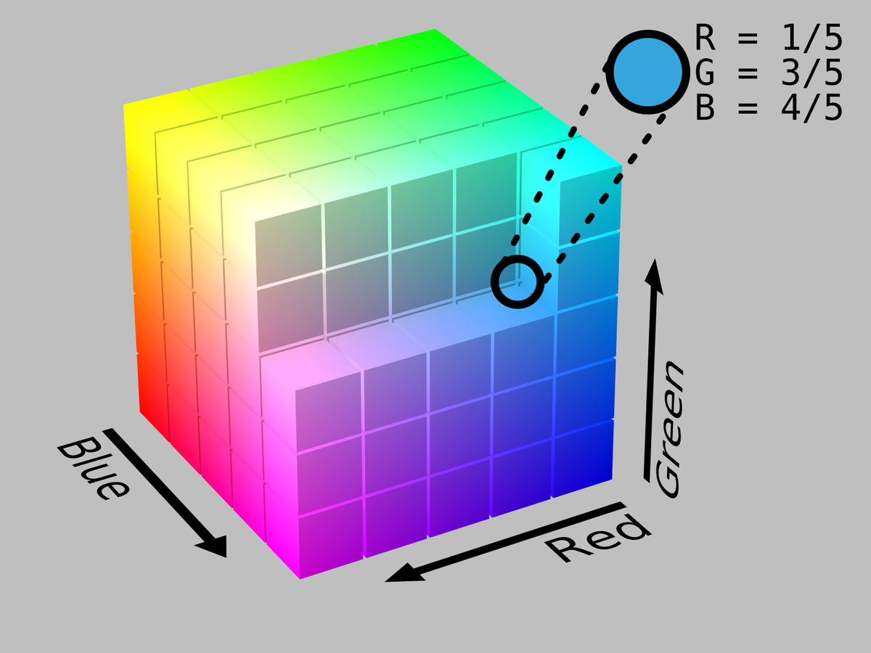
Fast Fourier Transform method
RGB color space
Lab color space
Notes:
There are several advantages to the separation of color from brightness information in image processing. Perceptual experimental evidence has established that the human
visual system has a much higher sensitivity to changes in brightness than to color.
Moreover, there seems to be general agreement that spatial resolution is markedly lower in chromatic (chrominance) channels than in the achromatic (luminance) one, hence high frequency information, i.e. fine details and edges, come mainly from the luminance channel [27], [5].
Thus, in developing our data hiding framework we avoid altering the luminance information in the carrier image altogether. This is a stark shift from mainstream data hiding techniques used today.

Slide 21
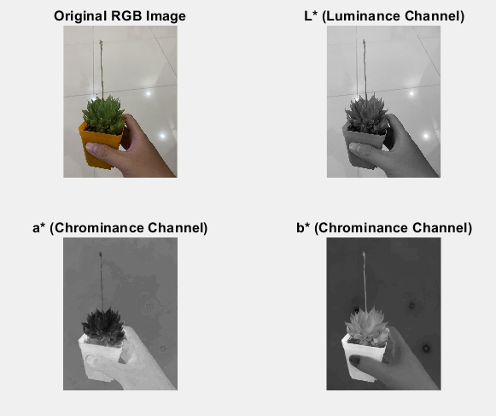
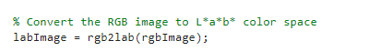
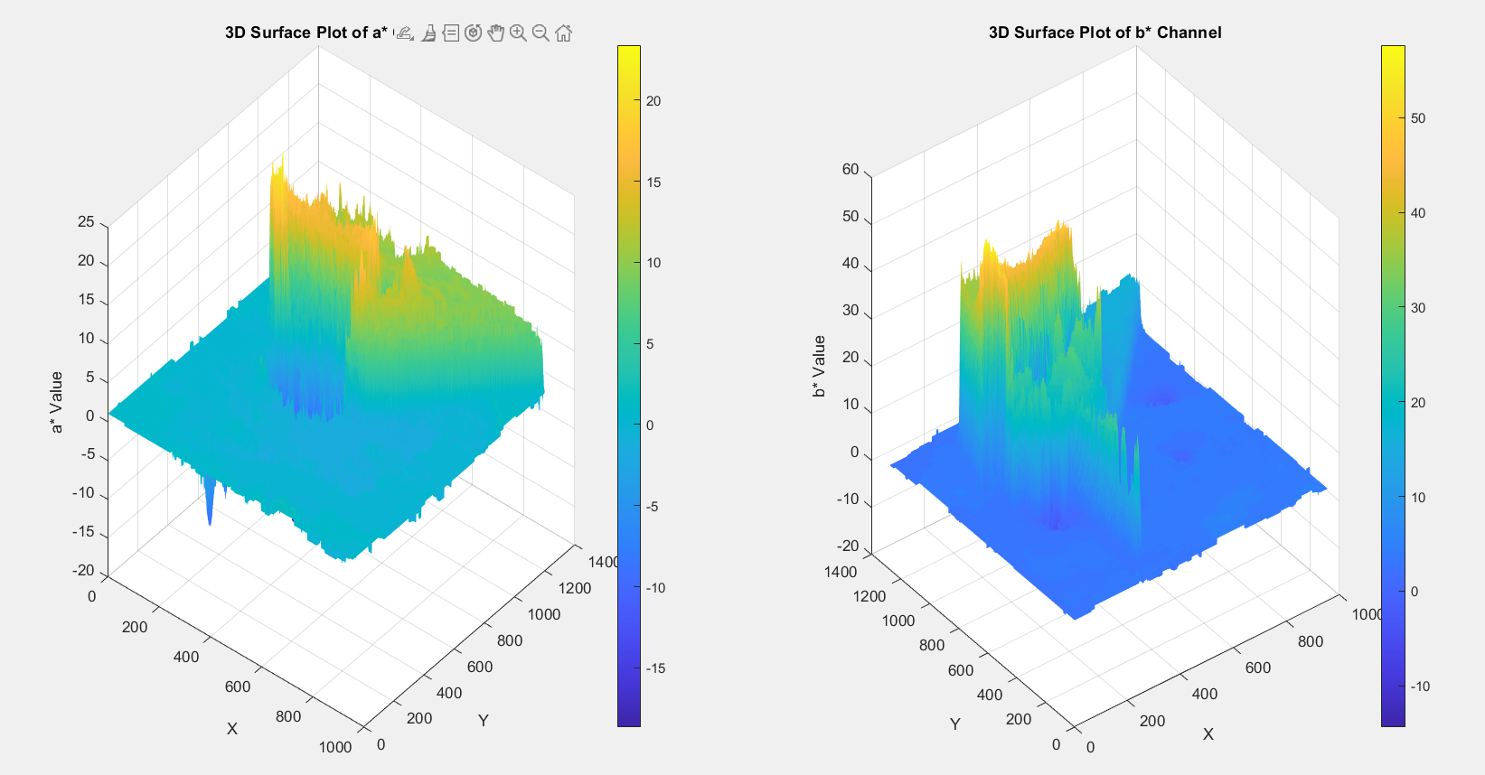
Result of the FFT method
1st RGB to Lab space

Slide 22
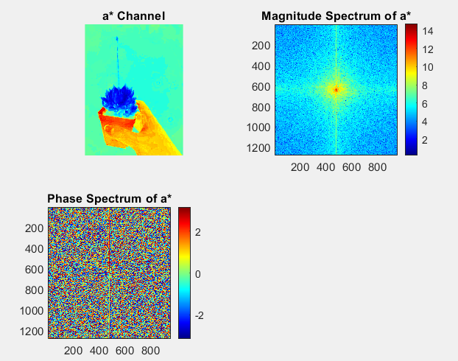
Result of the FFT method
Apply FFT 2D to the channel a*
% Apply 2D FFT to a* channel
fftA = fft2(a); % Compute FFT
fftA_shifted = fftshift(fftA); % Shift zero-frequency component to center
magnitudeA = abs(fftA_shifted); % Magnitude spectrum
phaseA = angle(fftA_shifted); % Phase spectrum

Slide 23
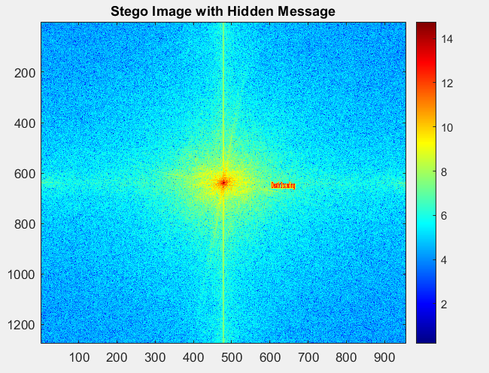

Result of the FFT method
Implement the image
% Embed the hidden message into the next-to-center region
for i = 1:embedSizeRows
for j = 1:embedSizeCols
magnitudeA(startRow + i - 1, startCol + j - 1) = ...
magnitudeA(startRow + i - 1, startCol + j - 1) + hiddenMessageResized(i, j);
end
end

Slide 24
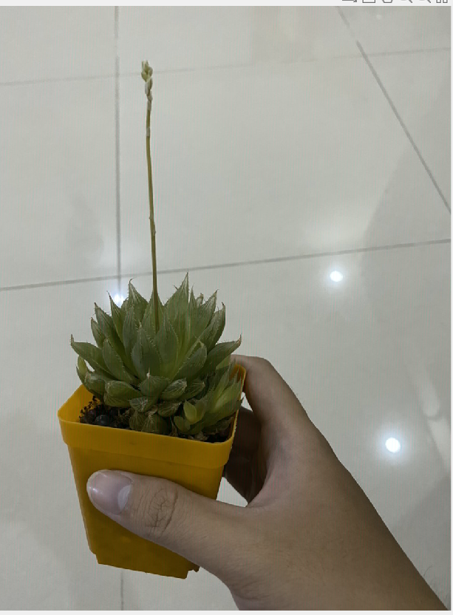
Result of the FFT method
4th Apply the IFFT and Lab to RGB space

Slide 25
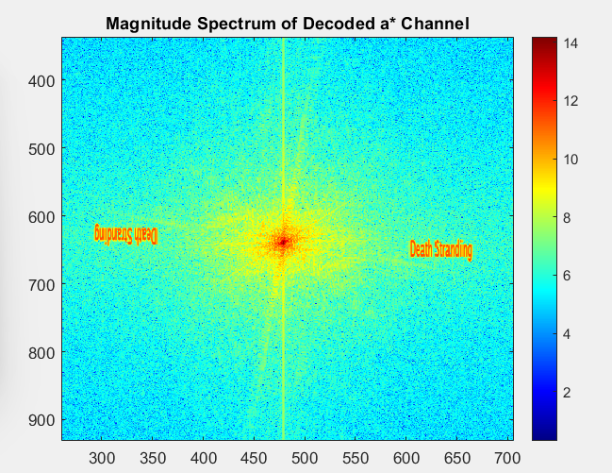

Result of the FFT method

Slide 26
Result of the FFT method
Discuss about the decode
1st mirror effect of the hidden message
Due to hiding the hidden message inside the magnitude
2nd the blurred message
Due to the IFFT process

Slide 27
Conclusion
Understanding more about the FT and DFT method (FFT method)
Build a MATLAB code to hide the message

Slide 28
References
https://www.researchgate.net/publication/357715100_Comprehensive_Survey_of_Multimedia_Steganalysis_Techniques_Evaluations_and_Trends_in_Future_Research
DSP Lecture from Vietnamese German University, 2021, EEIT
Real-time signal processing from Karlsruhe University of Applied science, 2024, SST
https://youtu.be/spUNpyF58BY?si=SAfSHHq7Rs2Qu1Uc

Slide 29
Thank you for listenning

Slide 30
PV fault analysis - detection

Slide 31
Introduction
PV systems are prone to faults such as open circuit, short circuit, and partial shading.
Fault detection improves reliability and efficiency.
Focus: Digital signal processing techniques for fault detection.

Slide 32
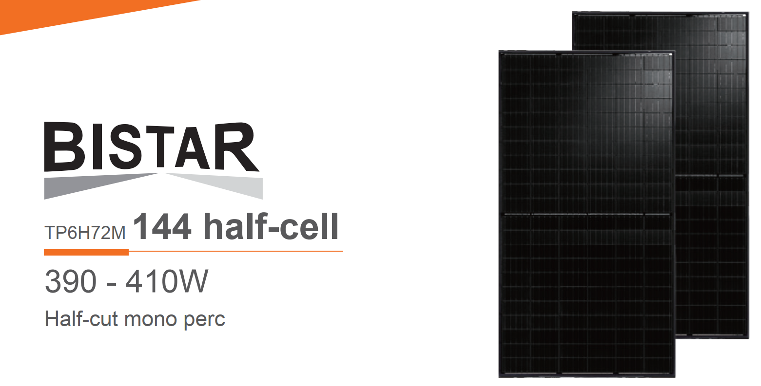
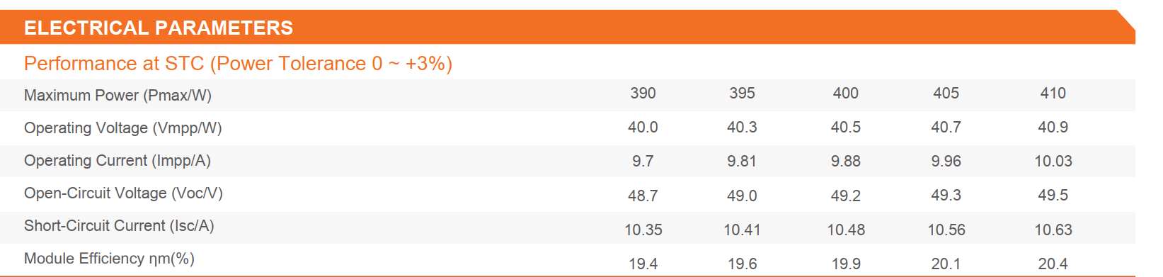
PV signal

Slide 33
Type of fault
Open Circuit:
Caused by loose connections or environmental issues.
Short Circuit:
Leads to large fault currents, reducing performance.
Partial Shading:
Results from dirt, debris, or shadows, creating hotspots.

Slide 34
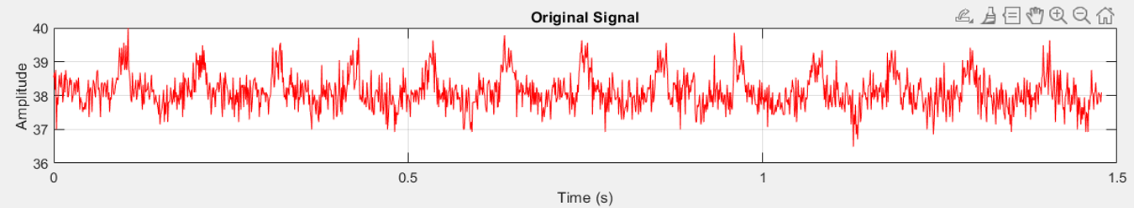
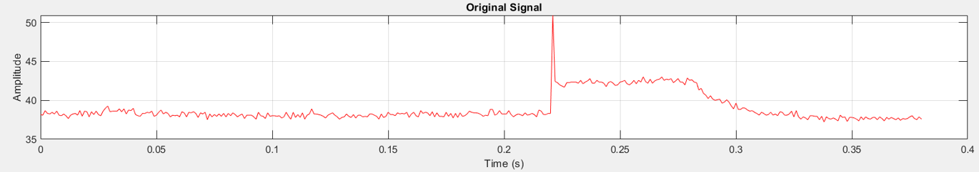
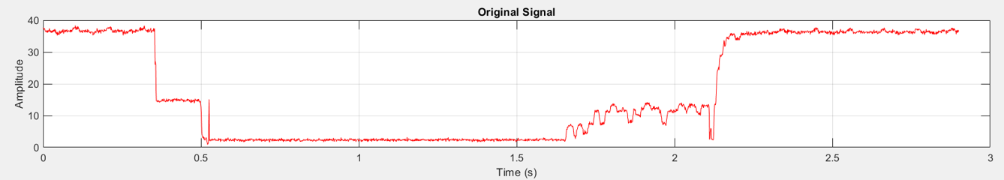
PV signal – voltage
Normal Condition
Short-circuit condition
Partial-shading condition

Slide 35
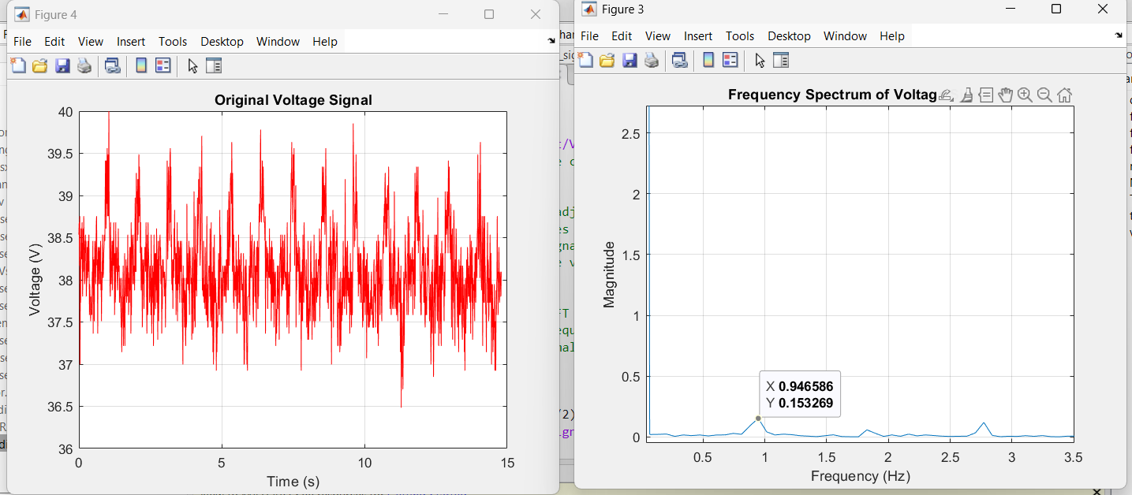
FFT – PV signal – normal condition

Slide 36
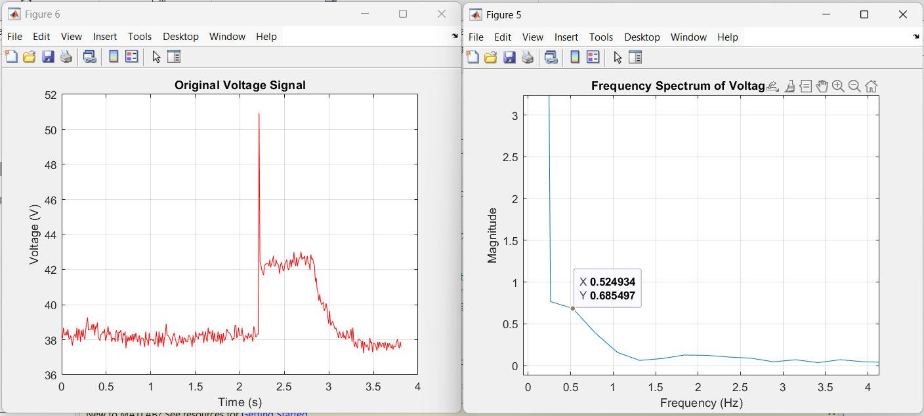
FFT – PV signal – SC condition

Slide 37
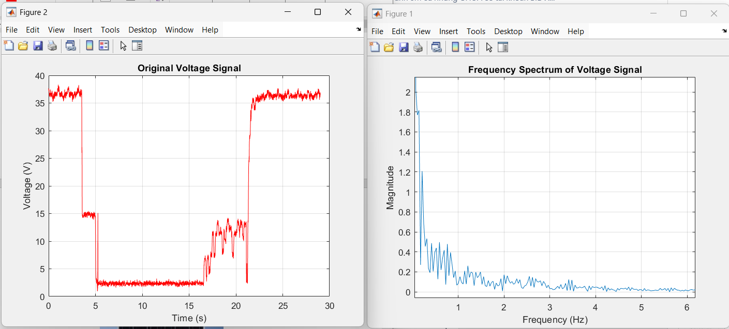
FFT – PV signal – Shading condition

Slide 38
Fault Detection
Smooth DC signals (optional) using moving average filter.
FFT (Fast Fourier Transform):
Converts signals to the frequency domain to identify specific faults.
Statistical Methods:
Detect anomalies using mean and standard deviation.
Threshold-Based Detection:
Sets upper and lower limits for fault identification.

Slide 39
Fault detection
Threshold method
Used when a specific limit is known (e.g., voltage exceeding 50V in a circuit).
Easy to implement in real-time systems.
Simple and computationally inexpensive.

Slide 40
Threshold based method
1st Check if there are fault in the frequency domain with value
Magnitude > 0.5 and Frequency > 0.5 Hz
2nd Check if the signal in time domain is in the range between 50 and 30V

Slide 41
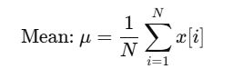
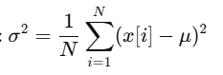
Statistical Fault Detection
Mean calculate
Variance
Used when statistical fluctuations or trends indicate faults (e.g., noise increase, load imbalance).
More sensitive to gradual or subtle changes.
Requires statistical computation, which may introduce additional complexity.

Slide 42
APENDIX: THEORETICAL BACKGROUND OF STEGANOGRAPHY
LSB – Least Significant Bit
10101001
RGB color model.
Re
Red: RGB(255, 0, 0) – RGB(11111111, 00000000, 00000000)
Green: RGB(0, 255, 0) – RGB(00000000, 11111111, 00000000)
Blue: RGB(255, 0, 0) – RGB(11111111, 00000000, 11111111)
Least Significant Bit

Slide 43
Example about LSB Steganography
0
255 (11111111)
0
0
252 (11111100)
0

Slide 44
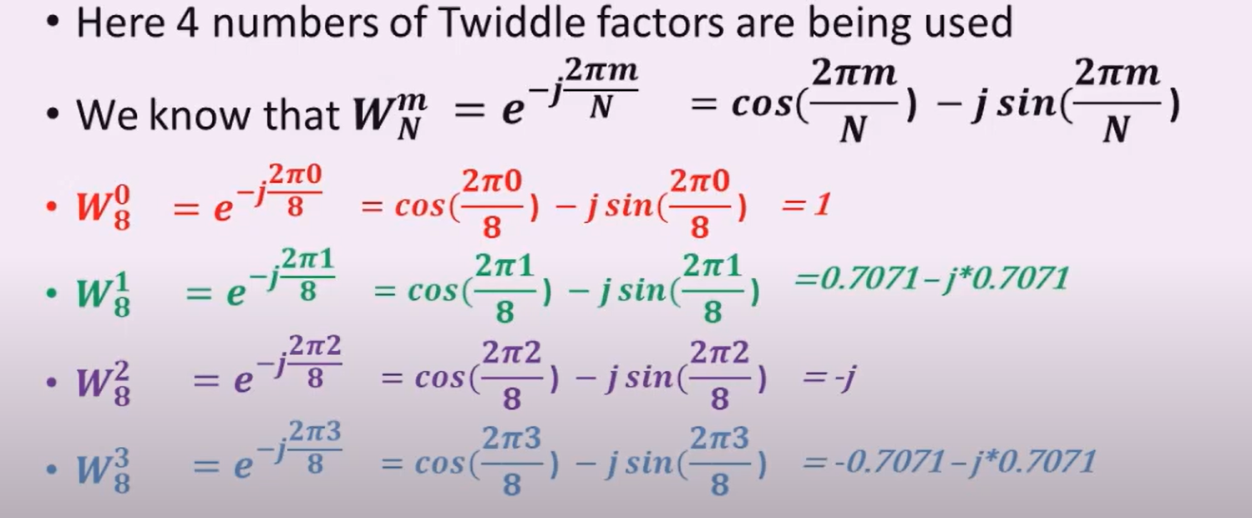

Slide 45
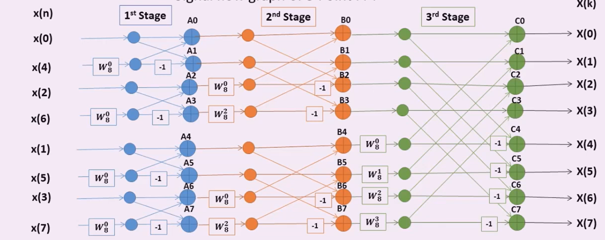
Example of the Butterfly in the FFT:

Slide 46
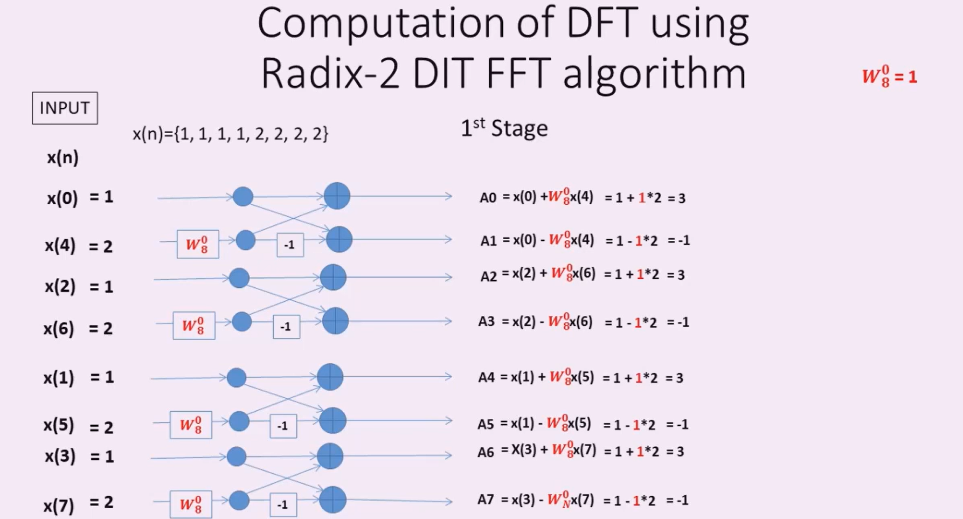

Slide 47
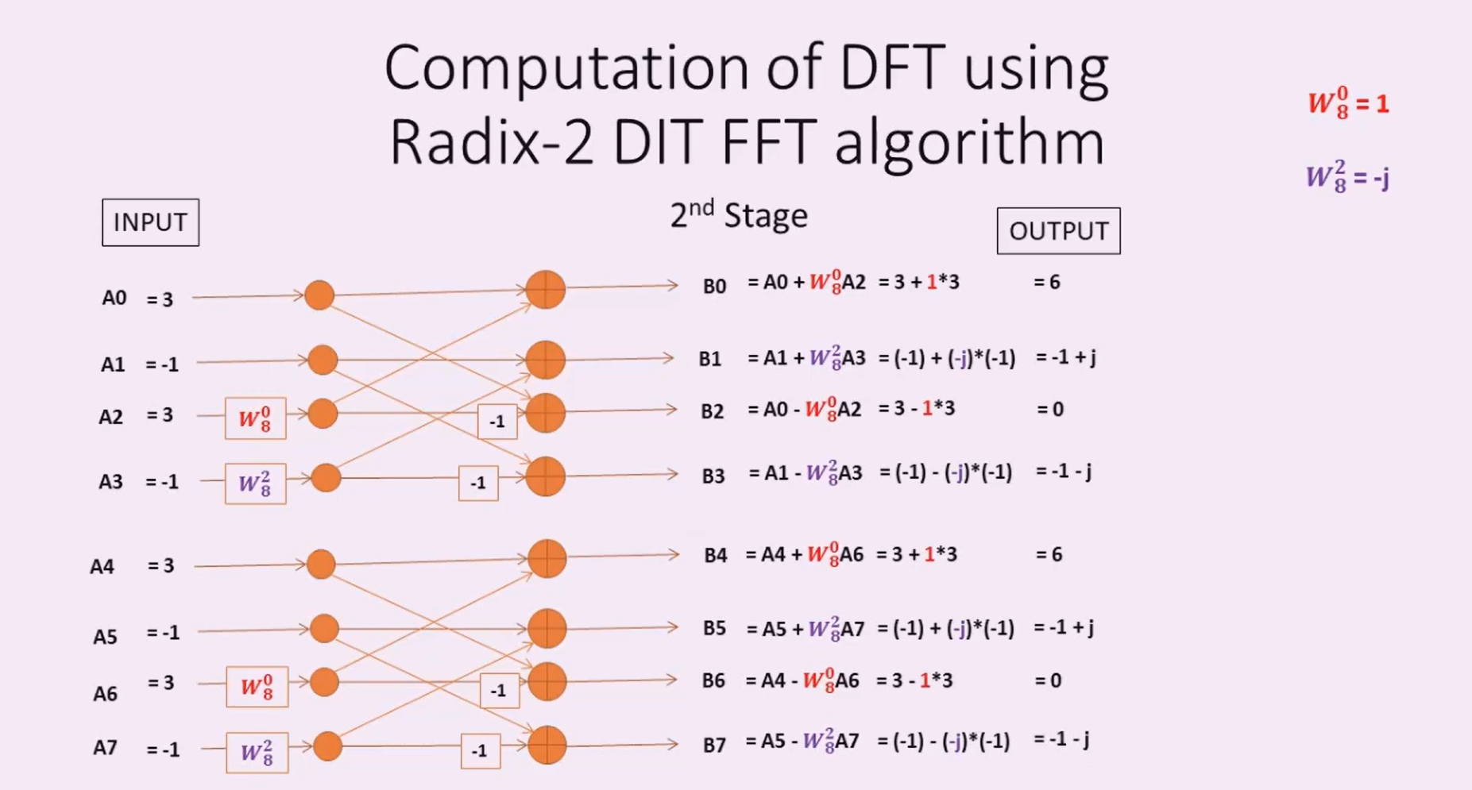

Slide 48
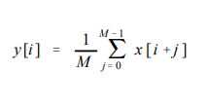
Moving average filter
operates by averaging a number of points from the input signal to produce each point in the output signal
x [ ] is the input signal,
y [ ] is the output signal, and
M is the number of points in the average

Slide 49
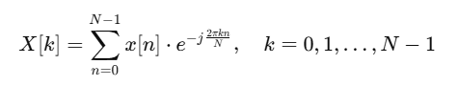
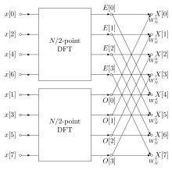
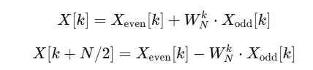
Fast Fourier Transform
FFT butterfly image
Notes:
The proof part is on the board.

